Slide 1

Ground Control to Major Tom
Ahmet Semih Kafkas
2022

Slide 2

Outline
Executive Summary
Introduction
Methodology
Results
Conclusion
Appendix

Slide 3
Executive Summary
Summary of Methodologies
Summary of All Results
Data Collection
Data Wrangling
Exploratory Data Analysis (EDA) with Structured Query Language(SQL) and Data Visualization
Data Visualization Applications with Folium and Dash
Exploratory Data Analysis (EDA) results
Predictive Analysis results

Slide 4
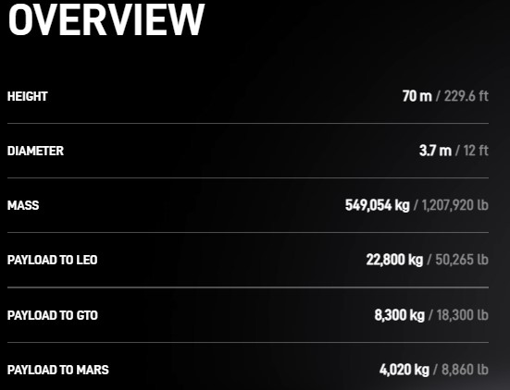
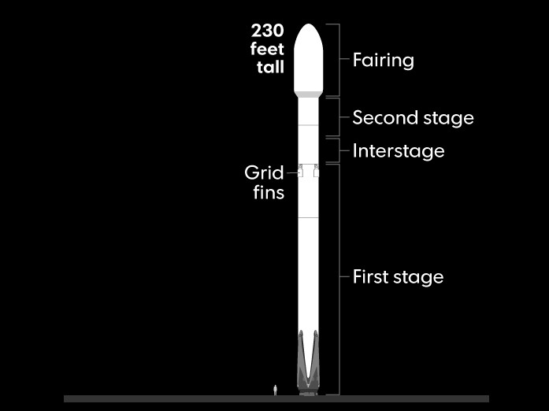
Introduction
The main purpose of this work to understand cost of famous company Space X and create an imaginary company which uses SpaceX data and resources to estimate cost of launches
With the technology SpaceX developed it is possible to lower the cost by reusing First Stage. For the understand the mechanism behind it you can follow up the links https://www.usatoday.com/pages/interactives/spacex-launch-graphic/
https://www.spacex.com/vehicles/falcon-9/

Slide 5
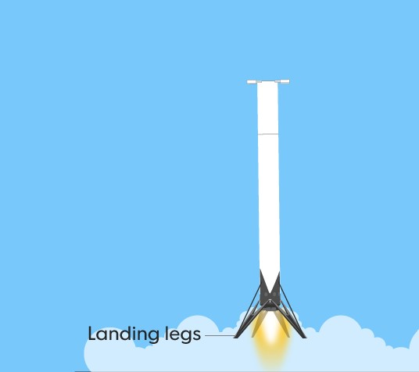
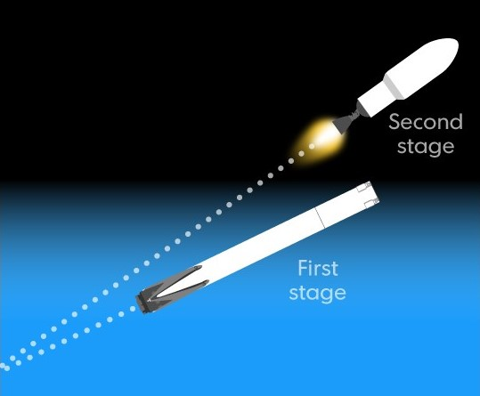
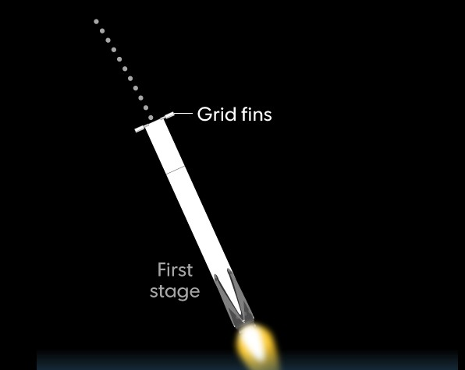
By investigating successful launches, it is possible to understand features
affecting the cost

Slide 6
Methodology-Data Collection
Data gathering is provided via SpaceX REST API (application programming interface) https://api.spacexdata.com/v4
By following the steps given in right, it is possible to reach booster name, the mass of the payload and the orbit that it is going to, the name of the launch site being used, the longitude, and the latitude.
The outcome of the landing, the type of the landing, number of flights with that core, whether gridfins were used, whether the core is reused, whether legs were used, the landing pad used, the block of the core which is a number used to seperate version of cores, the number of times this specific core has been reused, and the serial of the core.
1)Requesting API and parsing the SpaceX launch data
2) Filtering Falcon 9 launches
3) Dealing with Missing Values

Slide 7
Methodology-Web Scrapping
In order to collect data from the web https://en.wikipedia.org/wiki/List_of_Falcon\_9\_and_Falcon_Heavy_launches
BeautifulSoup functions are used to extract the data from Wiki.
Following steps are used to create .csv type data.
1) Extract a Falcon 9 launch records HTML table from Wikipedia
2) Parse the table and convert it into a Pandas dataframe
3) Converting dataframe into .csv format

Slide 8
Methodology-Web Scrapping
In order to collect data from the web https://en.wikipedia.org/wiki/List_of_Falcon\_9\_and_Falcon_Heavy_launches
BeautifulSoup functions are used to extract the data from Wiki.
Following steps are used to create .csv type data.
1) Extract a Falcon 9 launch records HTML table from Wikipedia
2) Parse the table and convert it into a Pandas dataframe
3) Converting dataframe into .csv format

Slide 9
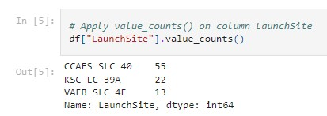
Methodology-Exploratory Data Analysis
1)Importing Pandas and NumPy Libraries
2)Identifying data types and missing values
The data contains several Space X launch facilities:
Cape Canaveral Space Launch Complex 40 VAFB SLC 4E ,
Vandenberg Air Force Base Space Launch Complex 4E
SLC-4E
Kennedy Space Center Launch Complex 39A KSC LC 39A
The location of each Launch Is placed in the column LaunchSite
3) Calculate the number of launches on each site with value_counts function applicable on DataFrame column “LaunchSite”

Slide 10
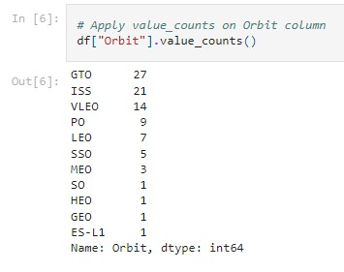
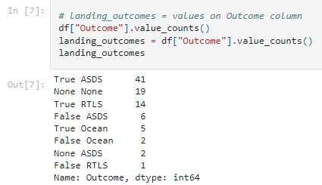
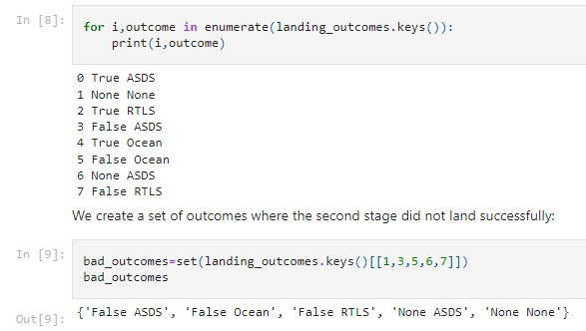
Methodology-Exploratory Data Analysis
4) Calculate the number and occurrence of each orbit with value_counts function applicable on DataFrame column “Orbit”
5) Calculate the number and occurrence of mission outcome per orbit type with value_counts function applicable on DataFrame column “Outcome”
6) Create landing class according to the values in Outcome column and measure the success rate

Slide 11
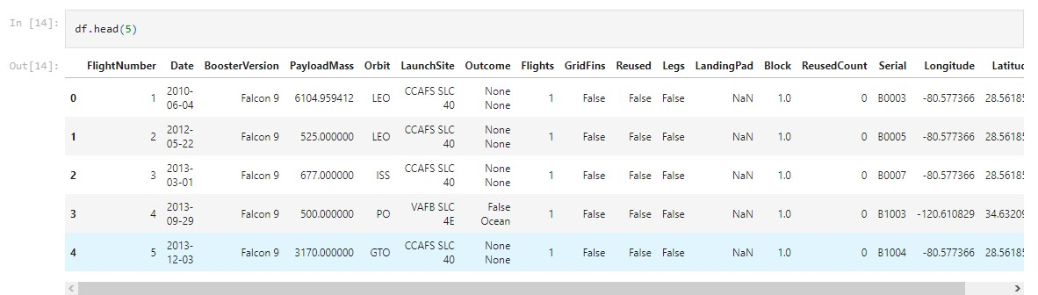
The success rate(the mean) is calculated as 0.66

Slide 12
Methodology-Exploratory Analysis Using SQL
1)Uploading data to IBM - DB2 Service
for combo usage SQL and Python
2) Displaying the names of the unique launch sites in the space mission
by SELECT …
3) Displaying 5 records where launch sites begin with the string 'CCA’ by
SELECT * FROM … WHERE… LIMIT 5
4) Displaying the total payload mass carried by boosters launched by NASA (CRS) by
SELECT SUM…AS….FROM…
5) Displaying average payload mass carried by booster version F9 v1.1
by SELECT AVG…. AS … FROM… WHERE
BOOSTER_VERSION = 'F9 v1.1'
6) Listing the date when the first successful landing outcome in ground pad was achieved by SELECT MIN… AS…\ WHERE
LANDING__OUTCOME = 'Success (ground pad)'
7) Listing the names of the boosters which have success in drone ship and have payload mass greater than 4000 but less than 6000 by
SELECT …FROM … WHERE LANDING__OUTCOME = 'Success (drone ship)' \AND PAYLOAD_MASS__KG_ > 4000 AND PAYLOAD_MASS__KG_ < 6000;

Slide 13
Methodology-Exploratory Analysis Using SQL
8) List the total number of successful and failure mission outcomes
List the names of the booster_versions which have carried the maximum payload mass. Use a subquery
List the failed landing_outcomes in drone ship, their booster versions, and launch site names for in year 2015
Rank the count of landing outcomes (such as Failure (drone ship) or Success (ground pad)) between the date 2010-06-04 and 2017-03-20, in descending order

Slide 14
Results EDA with SQL
Launch_Sites
CCAFS LC-40
CCAFS SLC-40
KSC LC-39A
VAFB SLC-4E
Total Payload Mass by NASA (CRS)
45596
First Succesful Landing Outcome in Ground Pad
2015-12-22
Average Payload Mass by Booster Version F9 v1.1
2928
Successful Mission | Failure Mission
100 | 1
Booster Versions which carried the Maximum Payload Mass
F9 B5 B1048.4
F9 B5 B1048.5
F9 B5 B1049.4
F9 B5 B1049.5
F9 B5 B1049.7
F9 B5 B1051.3
F9 B5 B1051.4
F9 B5 B1051.6
F9 B5 B1056.4
F9 B5 B1058.3
F9 B5 B1060.2
F9 B5 B1060.3
Month | booster_version | launch_site
January | F9 v1.1 B1012 | CCAFS LC-40
April | F9 v1.1 B1015 | CCAFS LC-40
Landing Outcome | Total Count
No attempt | 10
Failure (drone ship) | 5
Success (drone ship) | 5
Controlled (ocean) | 3
Success (ground pad) | 3
Failure (parachute) | 2
Uncontrolled (ocean) | 2
Precluded (drone ship) | 1

Slide 15
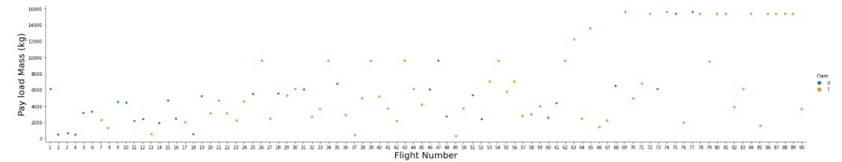
Methodology-EDA with Data Visualization
Importing pandas, NumPy , and Seaborn Libraries for Data Visualization
We can plot out the FlightNumber vs. PayloadMass and overlay the outcome of the launch.
We see that as the flight number increases, the first stage is more likely to land successfully. The payload mass is also important; it seems the more massive the payload, the less likely the first stage will return.
Reading the SpaceX dataset into a Pandas DataFrame and printing its summary

Slide 16
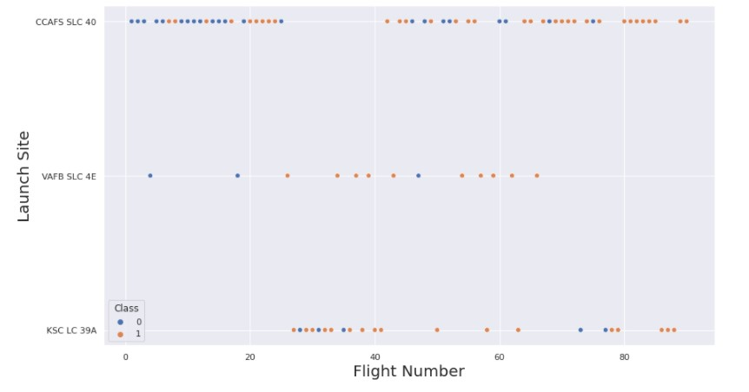
TASK 1- Plotting LaunchSite vs FlightNumber

Slide 17
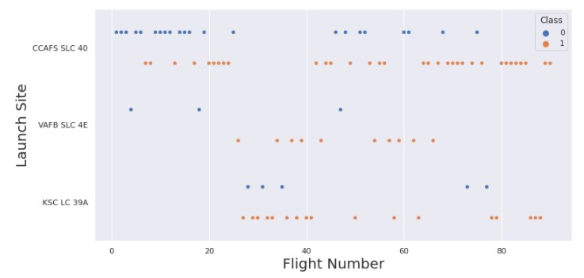
TASK 2- Plotting Payload vs FlightNumber

Slide 18
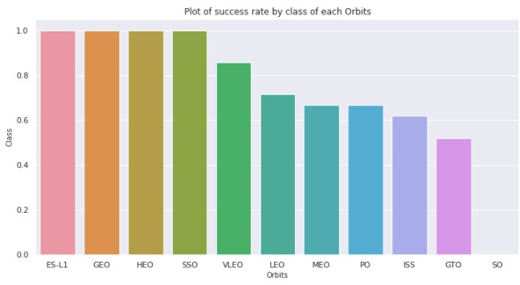
TASK 3-Visualizing the relationship between success rate of each orbit type

Slide 19
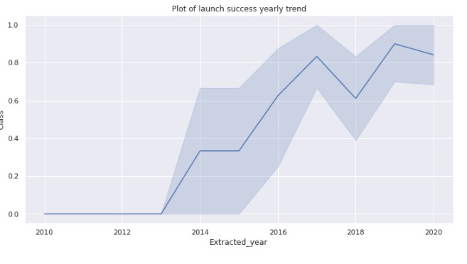
TASK 6-Visualizing the launch success yearly trend

Slide 20
Methodology-Launch Sites Locations Analysis with Folium
TASK 1: Mark all launch sites on a map
TASK 2: Mark the success/failed launches for each site on the map
TASK 3: Calculate the distances between a launch site to its proximities

Slide 21
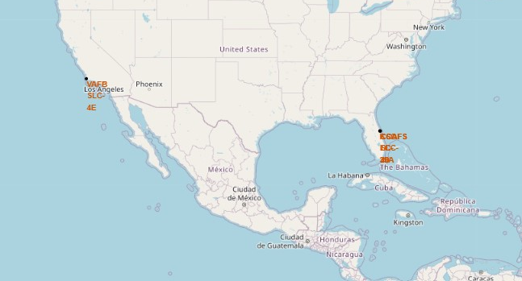

Slide 22
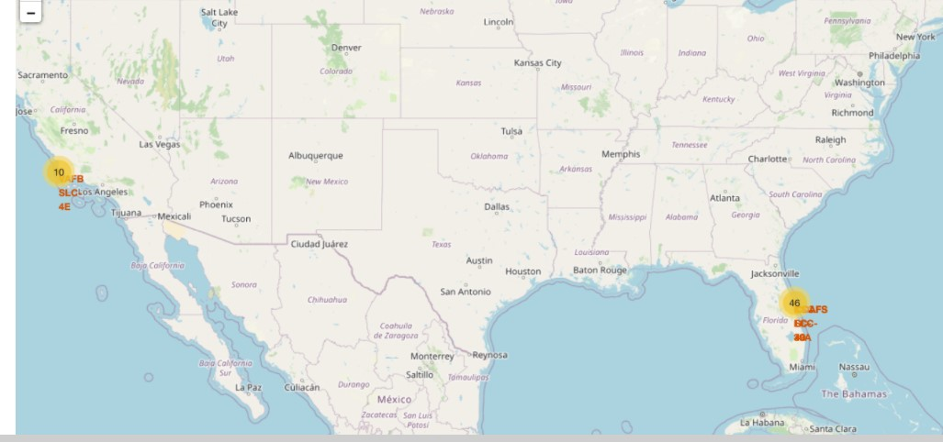

Slide 23
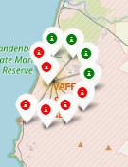
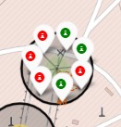
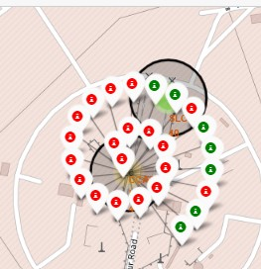
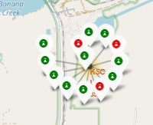
RESULTS OF LAUNCHS

Slide 24
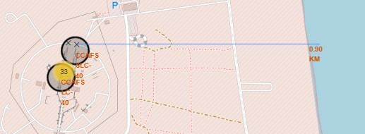
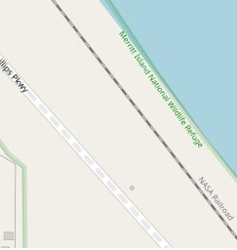
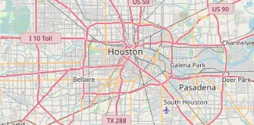
TASK 3: Calculate the distances between a launch site to its proximities

Slide 25
Methodology-Build an Interactive Dashboard with Ploty Dash
TASK 1: Add a Launch Site Drop-down Input Component
TASK 2: Add a callback function to render success-pie-chart based on selected site dropdown
TASK 3: Add a Range Slider to Select Payload
TASK 4: Add a callback function to render the success-payload-scatter-chart scatter plot

Slide 26
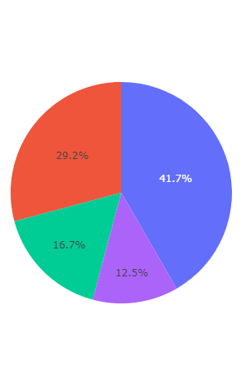
Methodology-Build an Interactive Dashboard with Ploty Dash
Questions to be answered:
Which site has the largest successful launches?
Which site has the highest launch success rate?
Which payload range(s) has the highest launch success rate?
Which payload range(s) has the lowest launch success rate?
Which F9 Booster version (v1.0, v1.1, FT, B4, B5, etc.) has the highest

Slide 27
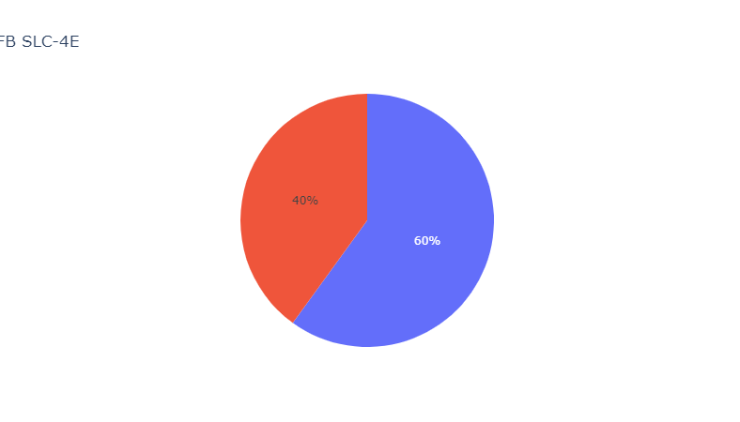
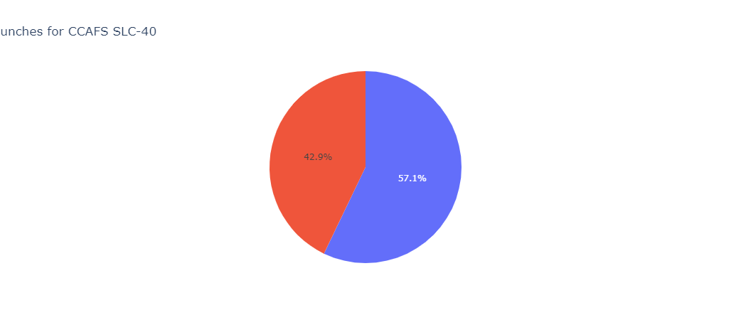
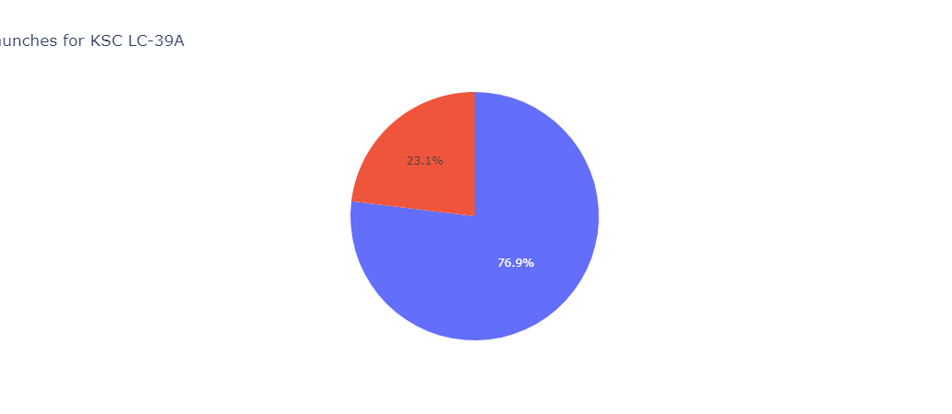
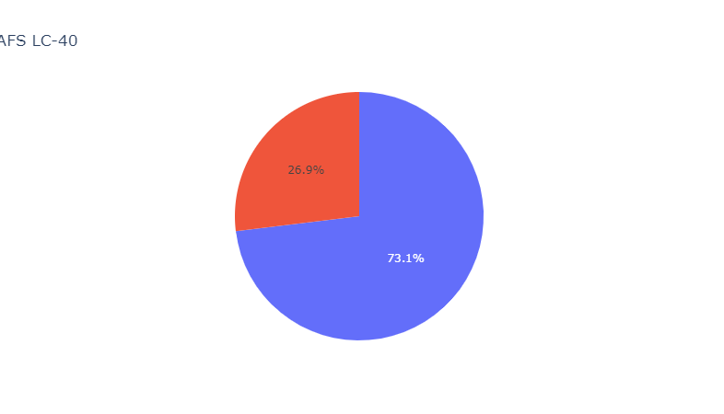

Slide 28
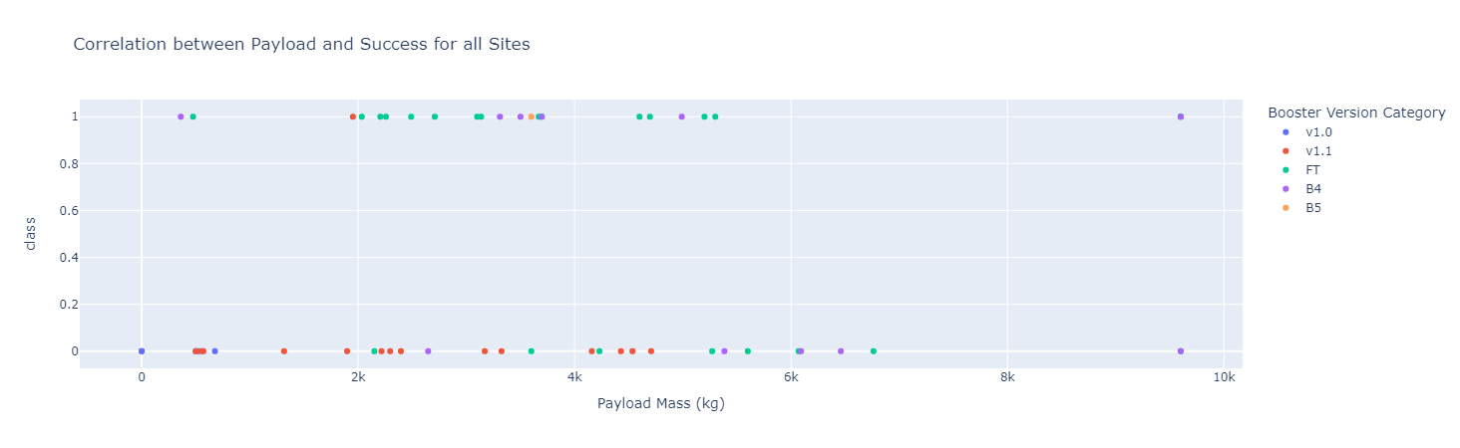
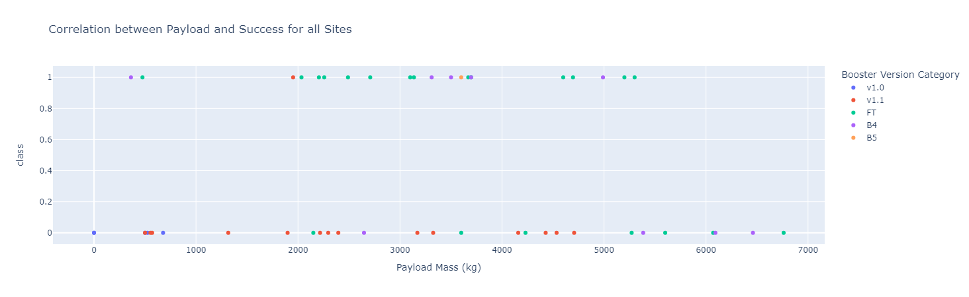

Slide 29
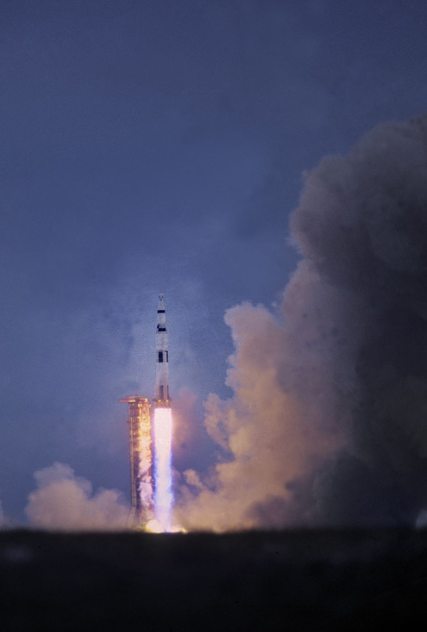
Questions to be answered:
Which site has the largest successful launches?
Ans: KSC LC 39-A(10)
Which site has the highest launch success rate?
Ans: KSC LC 39-A(0.769)
Which payload range(s) has the highest launch success rate?
Ans: 3000-4000,4700-5300
Which payload range(s) has the lowest launch success rate?
Ans: 5300-10000,0-2000
Which F9 Booster version (v1.0, v1.1, FT, B4, B5, etc.) has the highest
Ans: FT

Slide 30
Machine Learning
Four classification models
Logistic Regression
Support Vector Machine SVM
Decision Tree
K- Nearest Neighbor (KNN)
were tested for finding best fitting algorithm
For each method test size is equal to 0.2 while random_state is equal to 2.
For each method Confusion Matrix is plotted and accuracy is calculated.
In the following part you can see plots

Slide 31
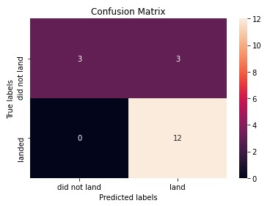
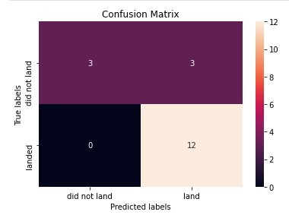
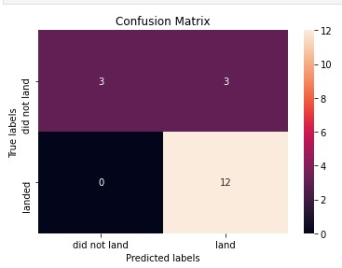
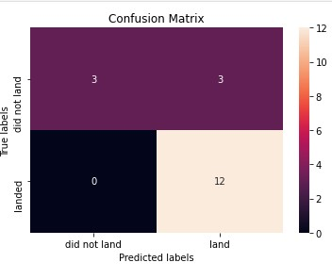

Slide 32
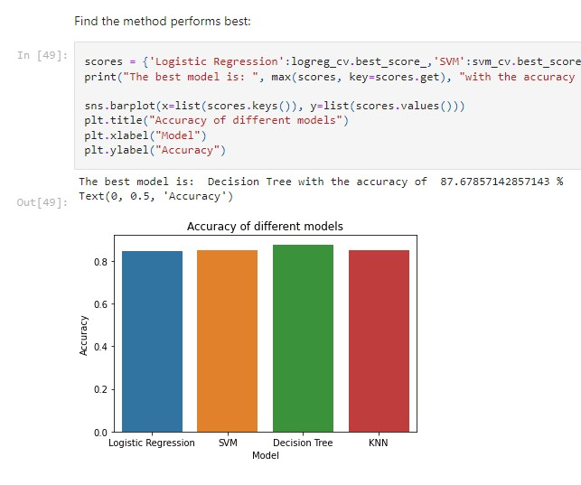
Test samples are 18.
Accuracy Results for the test data:
Logistic Regression: 0.8333
Support Vector Machine SVM 0.8333
Decision Tree 0.8333
K- Nearest Neighbor (KNN) 0.8333
Accuracy Results for the real data:
Logistic Regression: 0.8464
Support Vector Machine SVM 0.8482
Decision Tree 0.8768
K- Nearest Neighbor (KNN) 0.8482

Slide 33
Conclusion
In terms of Machine Learning, The Tree Classifier Algorithm(0.8768%) worked best for this dataset.
Low weighted payloads perform better than the heavier payloads
The success rates show that for SpaceX launches is improving directly proportional time in years. Experience Matters !
It is obvious that KSC LC-39A had the most successful launches from all the sites
Orbit GEO,HEO,SSO,ES-L1 has the best success Rate, vice-versa SO,GTO,ISS are most dangerous ones.

Slide 34
Appendix
Thanks to Coursera, Github,IBM, Stackoverflow and you as a reader.
I hope this course works well.

